Slide 1


CREDIT CARD FRAUD DETECTION USING ML
AAYUSH KUMAR
2019284
MENTOR -
DR. PRIYA MATTA
ASSOCIATE PROFESSOR,CSE

Slide 2



INTRODUCTION
Internet
Cyber crime refers to any crime that involves a computer/mobile and a network.
Most cybercrimes are carried out in order to generate profit for the cybercriminals.
Credit card fraud is also one of the cyber crimes where we detect whether the transaction is legit or fraudulent.
WHO ADMITS CYBER CRIME AND WHY ?

Slide 3


Problem statement
&
The Credit Card Fraud Detection Problem includes modeling past credit card transactions with the knowledge of the ones that turned out to be a fraud. This model is then used to identify whether a new transaction is fraudulent or not.

Slide 4
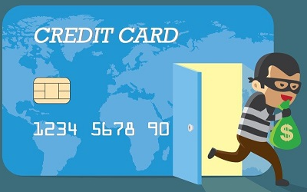
Methodology
#1
The basis of credit card fraud detection lies in the analysis of cardholder’s spending behavior
This spending profile is analyzed using optimal selection of variables that capture the unique behavior of a credit card and detect very dissimilar transactions within the purchases of a customer.
#2
#3
Our model has some major steps such as
DATA PREPROCESSING
DATA ANALYSIS
TRAIN AND TEST SPLIT

Slide 5
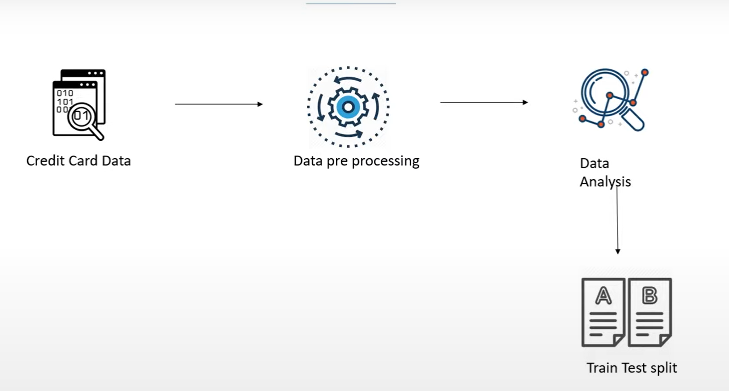
WORKFLOW

Slide 6

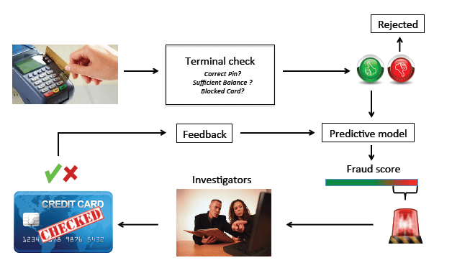
SOME OTHER VARIATION OF CREDIT CARD ATTACKS `
Binning and Carding is also becoming a major Cyber Attacks which is related to credit card and debit cards.
Attackers uses

Slide 7

Credit Card Fraud Detection
Testing set
Features
20%
Credit card Transaction Data
80%
Features
+
label
Training set
Random Forest Classifier
Model Evaluation

Slide 8
RESULT AND DISCUSSION
We have successfully created our Model
Which verifies the legitimate and fraudulent
transaction based of previous behavior
Our model can very accurately detect
Fraud transactions but still there is a
Chance of improvement in every model.

Slide 9
CONCLUSION
Our model checks the behavior of the transactions of the user, then matches up with the previous state of the expenditures and then predict the fallacy.
It has detected those transaction as fraud where user belongs to low category and high category payment is made or vice versa.
The mechanism require at least 10 transaction to determine accurately the transaction as fraud or not.

Slide 10

FUTURE ENHANCEMENTS
we did end up creating a system that can, with enough time and data, get very close to that goal. As with any such project, there is some room for improvement here. The very nature of this project allows for multiple algorithms to be integrated together as modules and their results can be combined to increase the accuracy of the final result.

Slide 11
THANK YOU

